Slide 1
Gesture Controlled Robot (GECOBOT)
Team 4
Gomathy Venkata Krishnan, Mark Kaldas, Tapas Sastry, Yebin Woo
github.com/GomathyVenkat/411Practicum

Slide 2
Problem
Joysticks are inefficient in many ways
There are no notable new ideas to remote control drivable objects
Current remote control methods do not have the ease of use desired for certain applications
Notes:
Joysticks have been around for too long, and they can be hard to use for some. We’ll go into their inefficiencies in the upcoming slides.
Given their popularity and appeal, we haven’t seen many products that try to replace them. An exploratory attempt to come up with something original could turn out to be beneficial in many ways.

Slide 3
Motivation
To explore and innovate
“Learning and innovation go hand in hand. The arrogance of success is to think what you did yesterday will be sufficient for tomorrow.”
-William G. Pollard
Physicist
Notes:
Innovation – this type of navigation unit is still not mass produced for people to enjoy. When people see that they can do things like this, a drive to innovate is born in them. This will popularize STEM.

Slide 4
Motivation
To explore and innovate
Ease of use
Notes:
Ease of use – using conventional systems (steering wheel, joystick) is easy, but this system can make things easier and more user friendly. Consider people with arthritis – if they can’t grip using their fingers, but can move their hands, they can steer a wheelchair with this system.

Slide 5
Motivation
To explore and innovate
Ease of use
Applicable to any moving device
Notes:
Medical applications – again, like those with arthritis: might be easier for some people to control something with gestures instead of a joystick.
Recreational – could be used to drive remote controlled cars, boats, drones, etc

Slide 6
Motivation
To explore and innovate
Ease of use
Applicable to any moving device
Low effort, wireless control
Notes:
Wireless control makes it easier. While it is susceptible to hacking, that problem can be solved with encryption

Slide 7
Motivation
To explore and innovate
Ease of use
Applicable to any moving device
Low effort, wireless control
It’s cool
Notes:
Think of how this idea can be improved. If it were implemented on a smartwatch, you would have a watch that controls a drone with just gestures. – that’s pretty cool. People love cool. Cool sells!

Slide 8
Objective
To design and build a working protoype of a remote control system that:
Relies on hand gestures to move drivable objects
Is easy to use
Is inexpensive (< $50 per unit)
Consumes low power
Serves as a proof of concept to be developed further for varied applications
Notes:
Controlling things with hand gestures comes to us naturally. There is no learning curve at all. Just move your hand to guide something.
Proof of concept – the idea here is not to overthrow the joystick in the near future. We just want to make a working prototype that could be developed further in the IoT space. This could be marketable with more work.

Slide 9
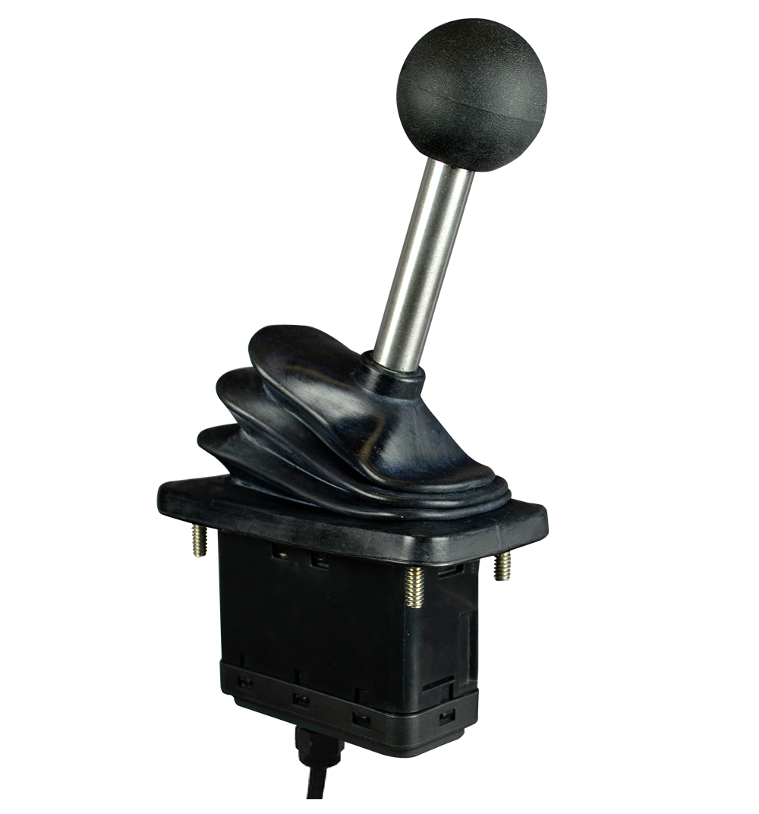
Alternatives
The joystick is the main alternative to our Gecobot system
Advantages | Disadvantages
Simple hardware | Mechanical parts can wear
Up to 6 degrees of freedom | Requires some effort to move
Programmable for: Force feedback Various transmission systems | High power consumption, usually plugged in to a wall outlet
Notes:
Joysticks involve mechanical extensions, anything mechanical is subject to wear. There are a lot of moving parts. A simple drop or manhandling could lead to failures.
They usually run off the wall – consume high power, aren’t mobile.
In a medical application, a joystick attached to a wheelchair could be broken. Or, it could be too hard for someone to move independently (people who don’t have a sense of touch for example)
Force feedback is a big plus, but most people don’t care for it. The benefits of gesture control outweigh the benefits of a joystick.

Slide 10
Alternatives
The joystick is the main alternative to our Gecobot system
Advantages | Disadvantages
Simple hardware | Mechanical parts can wear
Up to 6 degrees of freedom | Requires some effort to move
Programmable for: Force feedback Various transmission systems | High power consumption, usually plugged in to a wall outlet
Joysticks have been around for too long.
It is worth looking into alternatives to replace them.
Notes:
Explore and innovate – something new and improved can’t be so bad.

Slide 11
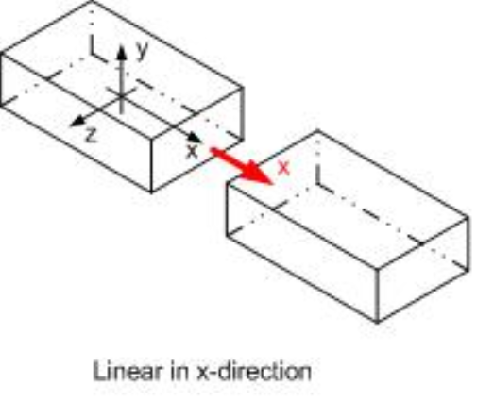
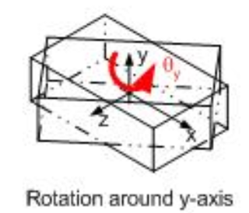
Requirements
Need a device that
Has the simplicity of a joystick
Has at least 2 degrees of freedom (forward/backward + yawing)
Notes:
We don’t have the time and budget to come up with something that has more than 2 degrees of freedom, but it can be done with a few modifications and a more advanced driver system.

Slide 12
Requirements
Need a device that
Has the simplicity of a joystick
Has at least 2 degrees of freedom (forward/backward + yawing)
Costs as much or less than a joystick
Is not susceptible to mechanical wear (no moving parts)
Can be controlled relatively effortlessly
Offers the precision of a joystick
Notes:
Cost – no point making something that does the same thing a joystick does for more money. People will make tradeoffs on performance if the cost is lower.
Wear – there are no moving parts here. It can be made more robust with a shell. The chances of mechanical wear are slim.
It’s as easy as moving your wrists. There is no gripping and tugging, no dexterity required.
With suitable filtering, the precision can be adjusted – just like a joystick!

Slide 13
Approach
Basic plan of action:
Accelerometer to read hand gestures
Processor to convert signal from accelerometer
Wireless transmit / receive system
Motor driver to drive a simple robot chassis
A budget of $200 (including spare parts, exploratory purchases and test circuit boards)
Notes:
We set out some basic goals and restrictions to stay within.
Focus is going to be on the controller. The robot chassis is just something to prove our controller circuit’s operation.

Slide 14
Approach – Schedule Overview (Test Board)
Initial groundwork
(10/02-10/10)
Look for similar projects online
See if idea can be achieved within budget
Set up wiki and drive for collaboration
Circuit design
(10/12-10/18)
Make list of parts, order them.
EagleCAD schematic and layout for test prototype
Block Testing
(10/21-10/27)
Accelerometer fundamental test
Voltage regulator output
Transmitter / receiver communication
Motor on power draw
Driver IC to motor output test
Build and test board
(11/1-11/6)
Print board in EPL for test layout
Verify etches
Solder through hole components
Perform initial tests for voltages, power consumption, code debug
Test drivability, debug issues
Code
(10/15-10/19)
Look for reusable code
Decide on how to code processor(s)
Set up environment
Notes:
Not going to go into heavy details for schedule – that will take too long. This is just an overview, and we’ve covered all major processes

Slide 15
Approach – Schedule Overview (Final Product)
(11/8-11/10)
Adjust circuit design and code to solve test board challenges, retest functionality
(11/10-11/13)
Prepare new schematic with Andrew’s guidelines
(11/13-11/16)
Extract layout on EagleCAD, verify OshPark DRC compliance
(11/16)
Send final layouts to OshPark after Andrew’s approval
(12/4-12/7)
Final setup, demo
(11/27-12/2)
Test performance, range, power draw. Document everything
(11/24-11/28)
Debug any issues on final boards
(11/24)
Solder 2 pairs of transmitter and receiver boards

Slide 16
Hardware Design – Transmitter Board (Block Diagram)
7805T
5V Regulator
9V Power Supply
1117
3.3V Regulator
ISP
Programmer
Atmega328
Microcontroller
ADXL335
Accelerometer
HT12E
Encoder
Transmitter
433 MHz
Signal Out
Notes:
Design didn’t consist of figuring out RLC values, impedances, etc. It was just putting blocks together and some calculated decisions.
We wanted to customize the voltage regulators, but decided to use standard VR chips anyway to simplify things.

Slide 17
Hardware Design – Receiver Board (Block Diagram)
9V Power Supply
7805T
5V Regulator
Signal In
Receiver
433 MHz
HT12D
Decoder
L293D
Driver IC
Motors
LEDs
Notes:
Lower level blocks in backup slides

Slide 18
Software Design – High Level Algorithm
Read (X, Y) coordinates from accelerometer
X tilt > 30°
X tilt < -30°
Y tilt < -30°
Y tilt > 30°
No Tilt
RM Clockwise
LM Counter-Clockwise
Yaw left
RM Counter-Clockwise
LM Clockwise
Yaw right
RM Clockwise
LM Clockwise
Forward
RM Counter-Clockwise
LM Counter-Clockwise
Backward
All Motors Stop

Slide 19
Software Design – Low Level Algorithm
Setup:
{
Set pin 10 – 13 as Output
Set accelerometer origin (No tilt) by checking for accelerometer stability
}

Slide 20
Software Design – Low Level Algorithm
LOOP:
Read accelerometer x and y
Define x and y relative to origin
if(x<-30)
RIGHT
Pin 10 & 13 HIGH
else if(x>30)
LEFT
Pin 11 & 12 HIGH
else if(y<-30)
Forward
Pin 11 & 13 HIGH
else if(y>30)
Backward
Pin 10 & 12 HIGH
Else
STOP
Pin 10 – 13 LOW

Slide 21
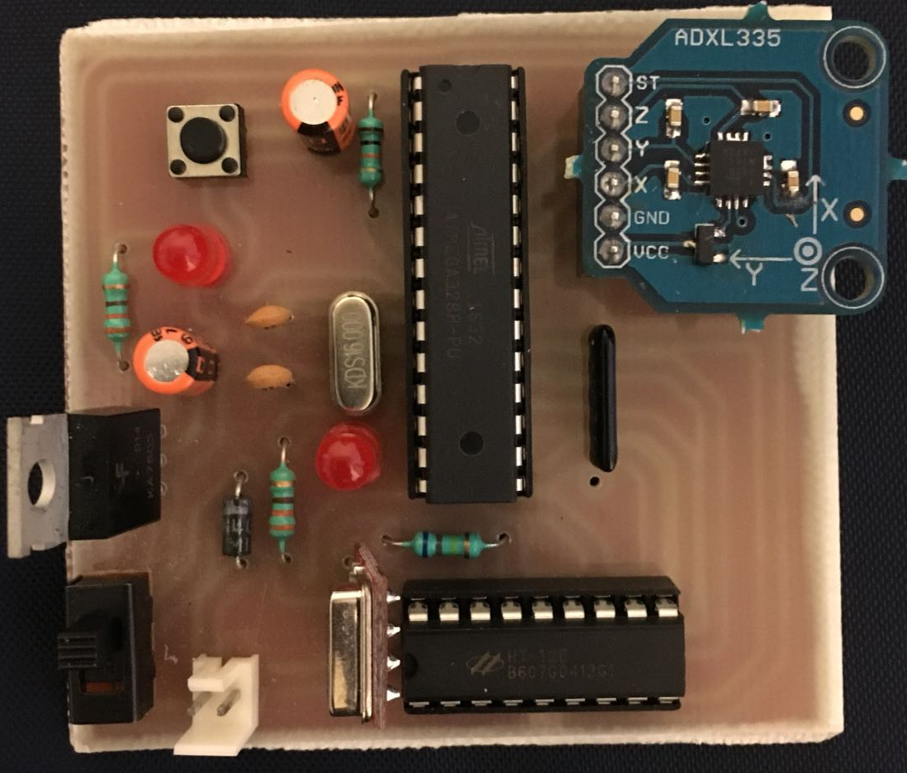
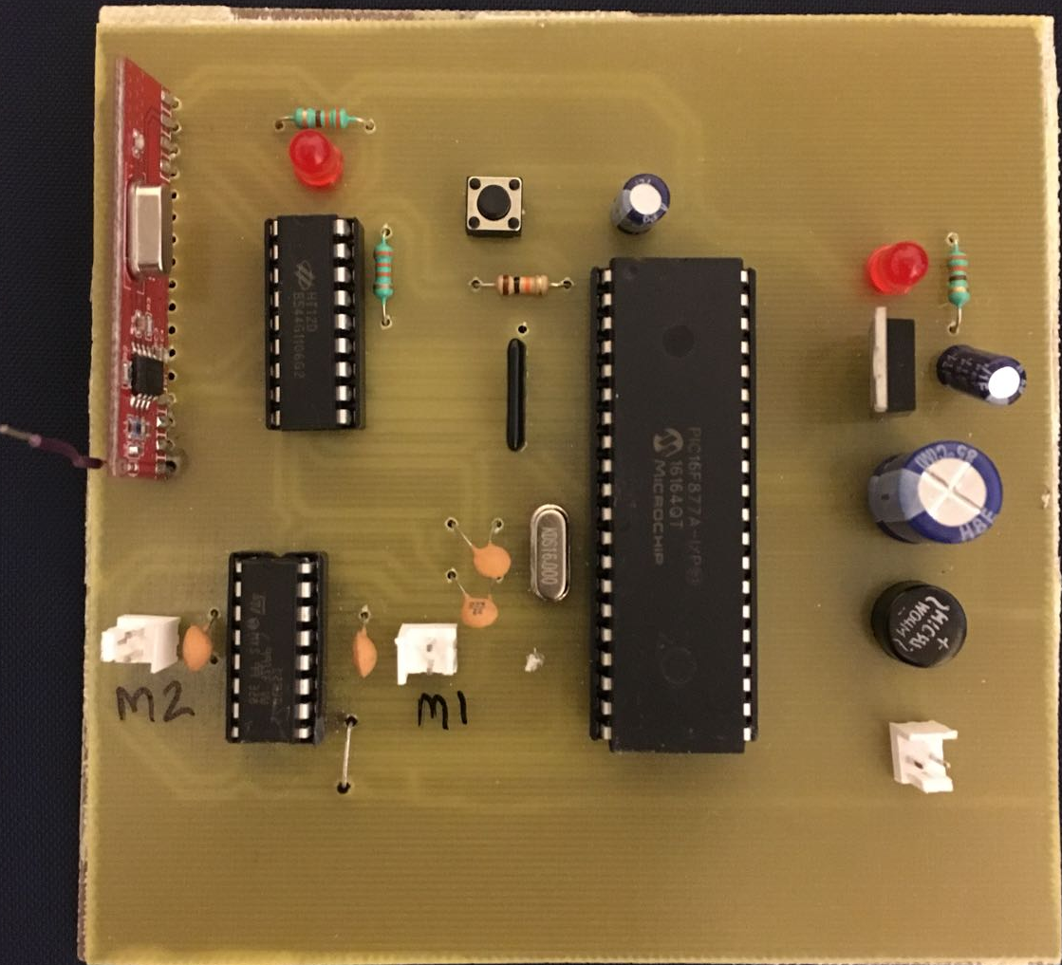
Implementation – Test Board
https://drive.google.com/open?id=1czeJDhGI3ouBHFwLqvQFBY2Zgq8MpFJ-
Notes:
We won’t go into schematic / layout of this board. This was our minimalistic test implementation, and we just built it to see if the parts work together and the whole idea works.
Note the Rx side uses a PIC microcontroller. This was present in our initial design, and we got rid of it because we realized the system works just as well without it – one less part. Also, we save on so much real estate.
Just leave slide on for few seconds, Gomathy will take questions about this board.

Slide 22
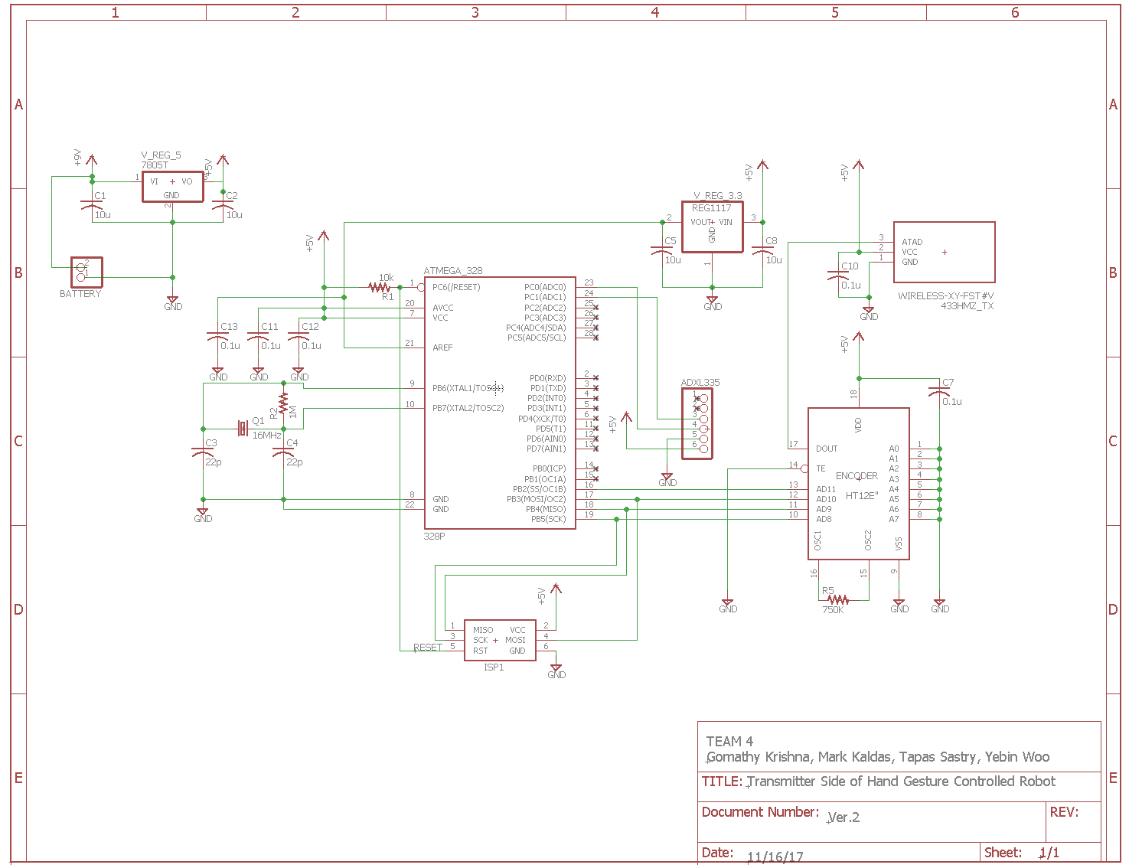
Implementation – Transmitter Schematic
Notes:
Prep for any questions
Know what all components do

Slide 23
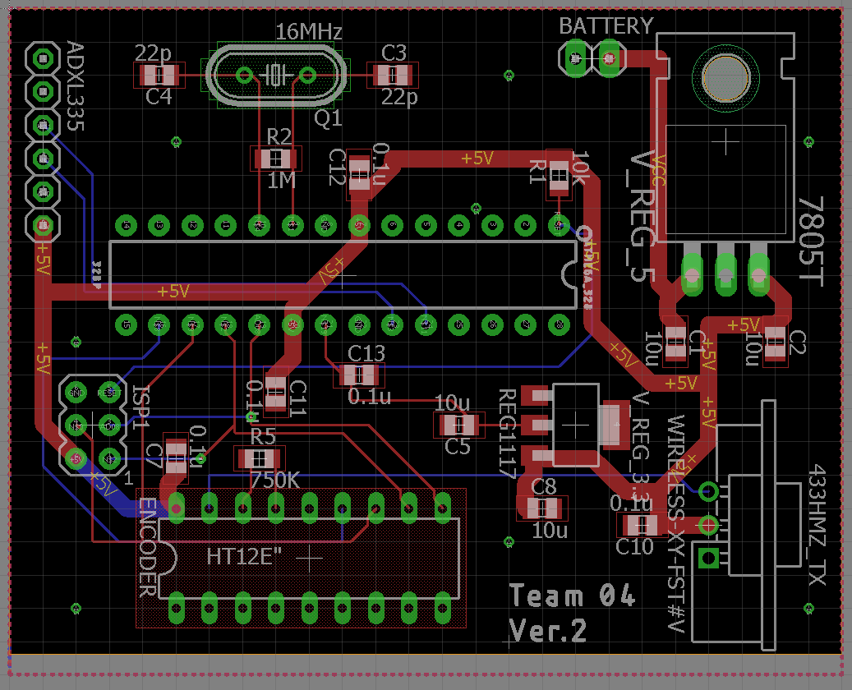
Implementation – Transmitter Layout

Slide 24
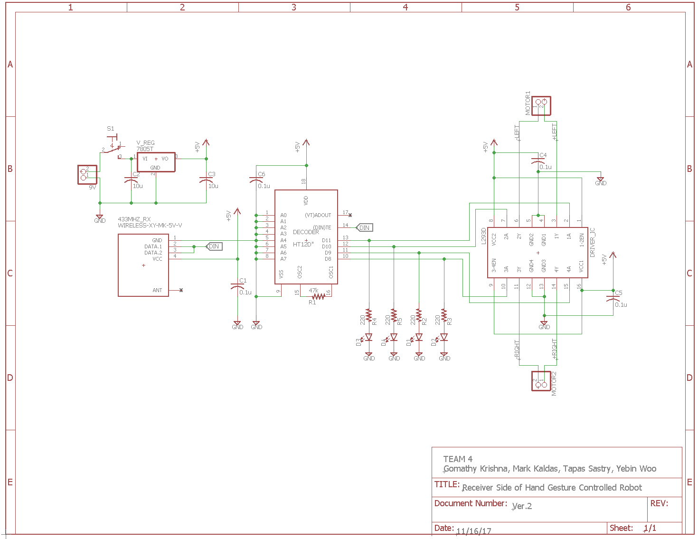
Implementation – Receiver Schematic

Slide 25
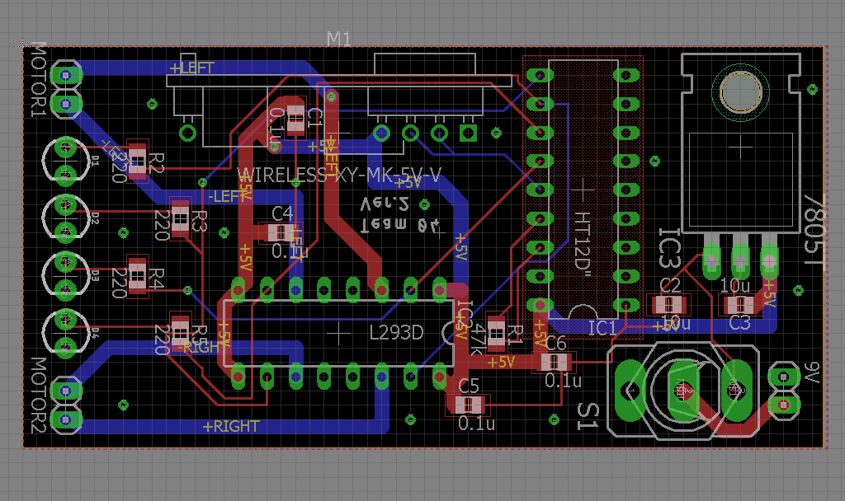
Implementation – Receiver Layout

Slide 26
Implementation – Bill of Materials
Component | Quantity | Unit Cost ($) | Total Cost ($)
Surface Mount Resistors
220 | 4 | 0.01 | 0.04
2.2 k | 1 | 0.01 | 0.01
10 k | 1 | 0.01 | 0.01
47 k | 1 | 0.01 | 0.01
68 k | 1 | 0.01 | 0.01
680 k | 1 | 0.01 | 0.01
1 M | 1 | 0.01 | 0.01
Surface Mount Capacitors
22 p | 2 | 0.01 | 0.02
0.1 µ | 9 | 0.01 | 0.09
10 µ | 6 | 0.01 | 0.06

Slide 27
Implementation – Bill of Materials
Component | Quantity | Unit Cost ($) | Total Cost ($)
Integrated Circuit Chips
Voltage Regulator 7805T | 2 | 0.20 | 0.40
Atmel Atmega 328 PU | 1 | 7.68 | 7.68
Encoder HT12E | 1 | 1.75 | 1.75
Decoder HT12D | 1 | 1.95 | 1.95
Transmitter/Receiver UCEC XY-MK-5V 433 MHz | 1 | 1.83 | 1.83
Accelerometer ADXL335 | 1 | 14.99 | 14.99
IC Sockets and Pin Headers
28-pin socket | 1 | 0.5 | 0.5
18-pin socket | 2 | 0.25 | 0.5
16-pin socket | 1 | 0.5 | 0.5
6-pin GPIO header | 1 | 0.5 | 0.5
2x3 6-pin ISP header | 1 | 0.5 | 0.5

Slide 28
Implementation – Bill of Materials
Component | Quantity | Unit Cost ($) | Total Cost ($)
Misc Parts
16 MHz Xtal Oscillator | 1 | 0.24 | 0.24
Red LED | 4 | 0.10 | 0.40
2-pin push button | 2 | 0.50 | 1.00
2-pin male burge | 1 | 0.50 | 0.50
2-pin PCB connector | 4 | 0.50 | 2.00
9 V Battery | 2 | 3.00 | 6.00
Robot Chassis w 2 motors | 1 | 10.99 | 10.99
Jumper cables | 10 | 0.01 | 0.10
OshPark PCB Pair | 1 | 14.57 | 14.57
Total cost for Tx / Rx boards |  |  | 67.17

Slide 29
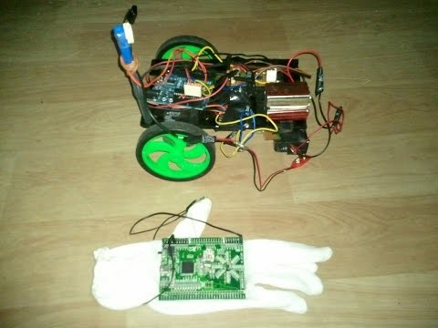
Design / Process Credits (IP)
Idea for project was inspired by this IEEE Publication:
T. Lu, “A motion control method of intelligent wheelchair based on hand gesture recognition,” 2013 IEEE 8th Conference on Industrial Electronics and Applications (ICIEA), 2013.
Design and implementation was inspired by:
Singh, Nitin, director. MAKING OF HAND GESTURE CONTROLLED ROBOT CAR USING ARDUINO. YouTube, 23 Jan. 2017, www.youtube.com/watch?v=gG7wDuKoA3I.
Notes:
IEEE paper by Tao Lu was written specifically for wheelchairs. We took that concept and built on it for other applications as well
The video uses a wired system and an Arduino.

Slide 30
Testing - Hardware
Step 1
Step 2
Step 3
Unit testing
Test each component or module to make sure they are functioning as it is.
Integrated testing
Test the function of two or three components / modules together and see if they performed as we expected.
System testing
Test the function of overall product with implementation of simple code.

Slide 31
Testing - Software
Step 1
Step 2
Step 3
Unit testing
Test if each motor responds to HIGH or LOW independently
Tested if accelerometer values were read continuously without delays and added a stability function to fix the issue
Integrated testing
Tested if all the LEDs blinked depending on the change in direction of the chassis.
Tested if the wheels turned in the required direction
System testing
Tested the Rx and Tx board together to ensure no delays, no stalling and no instability issues are faced.
Checked if LED and chassis response were synchronized.

Slide 32
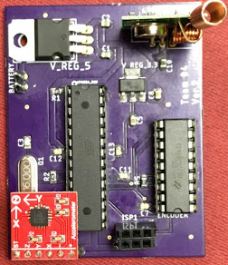
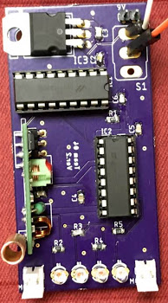
Results – Finished Boards
Transmitter
Receiver

Slide 33
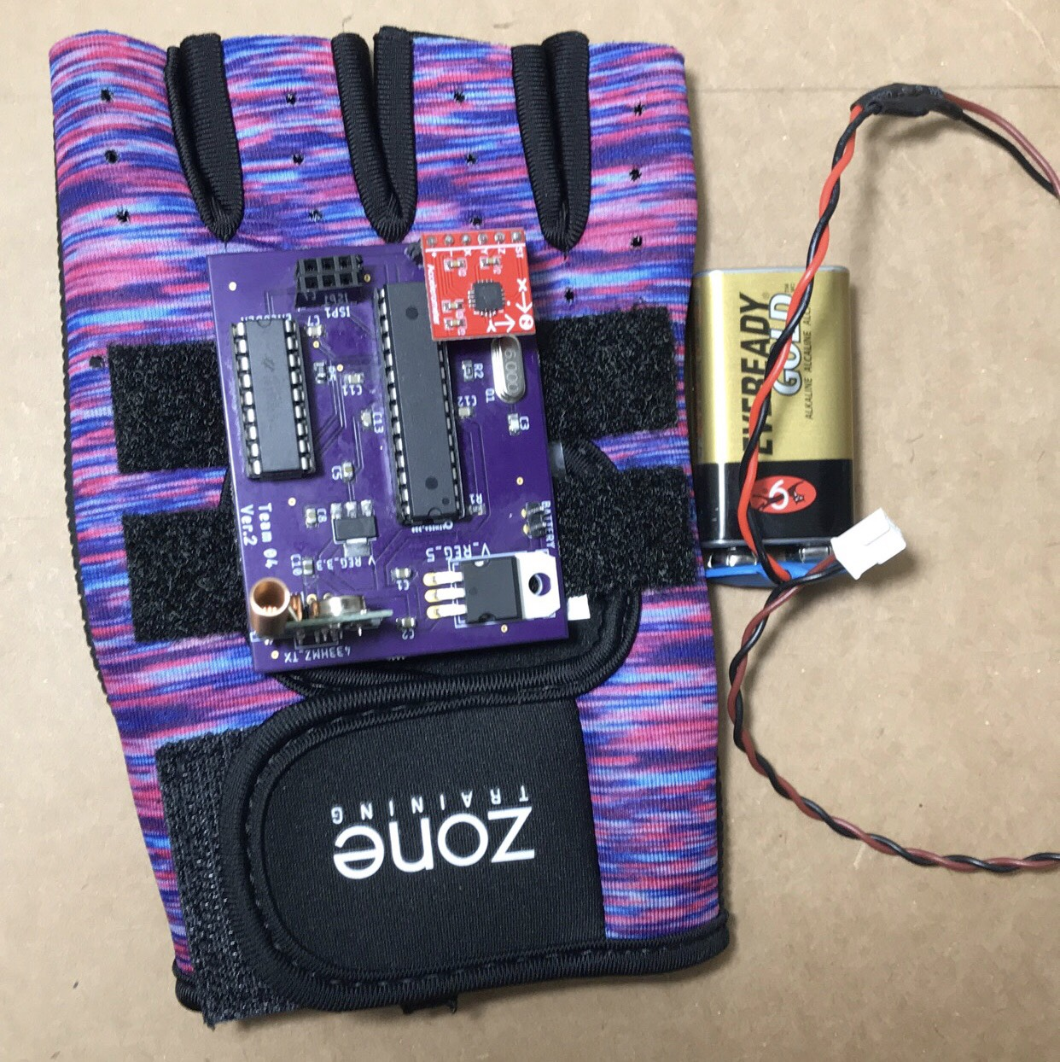
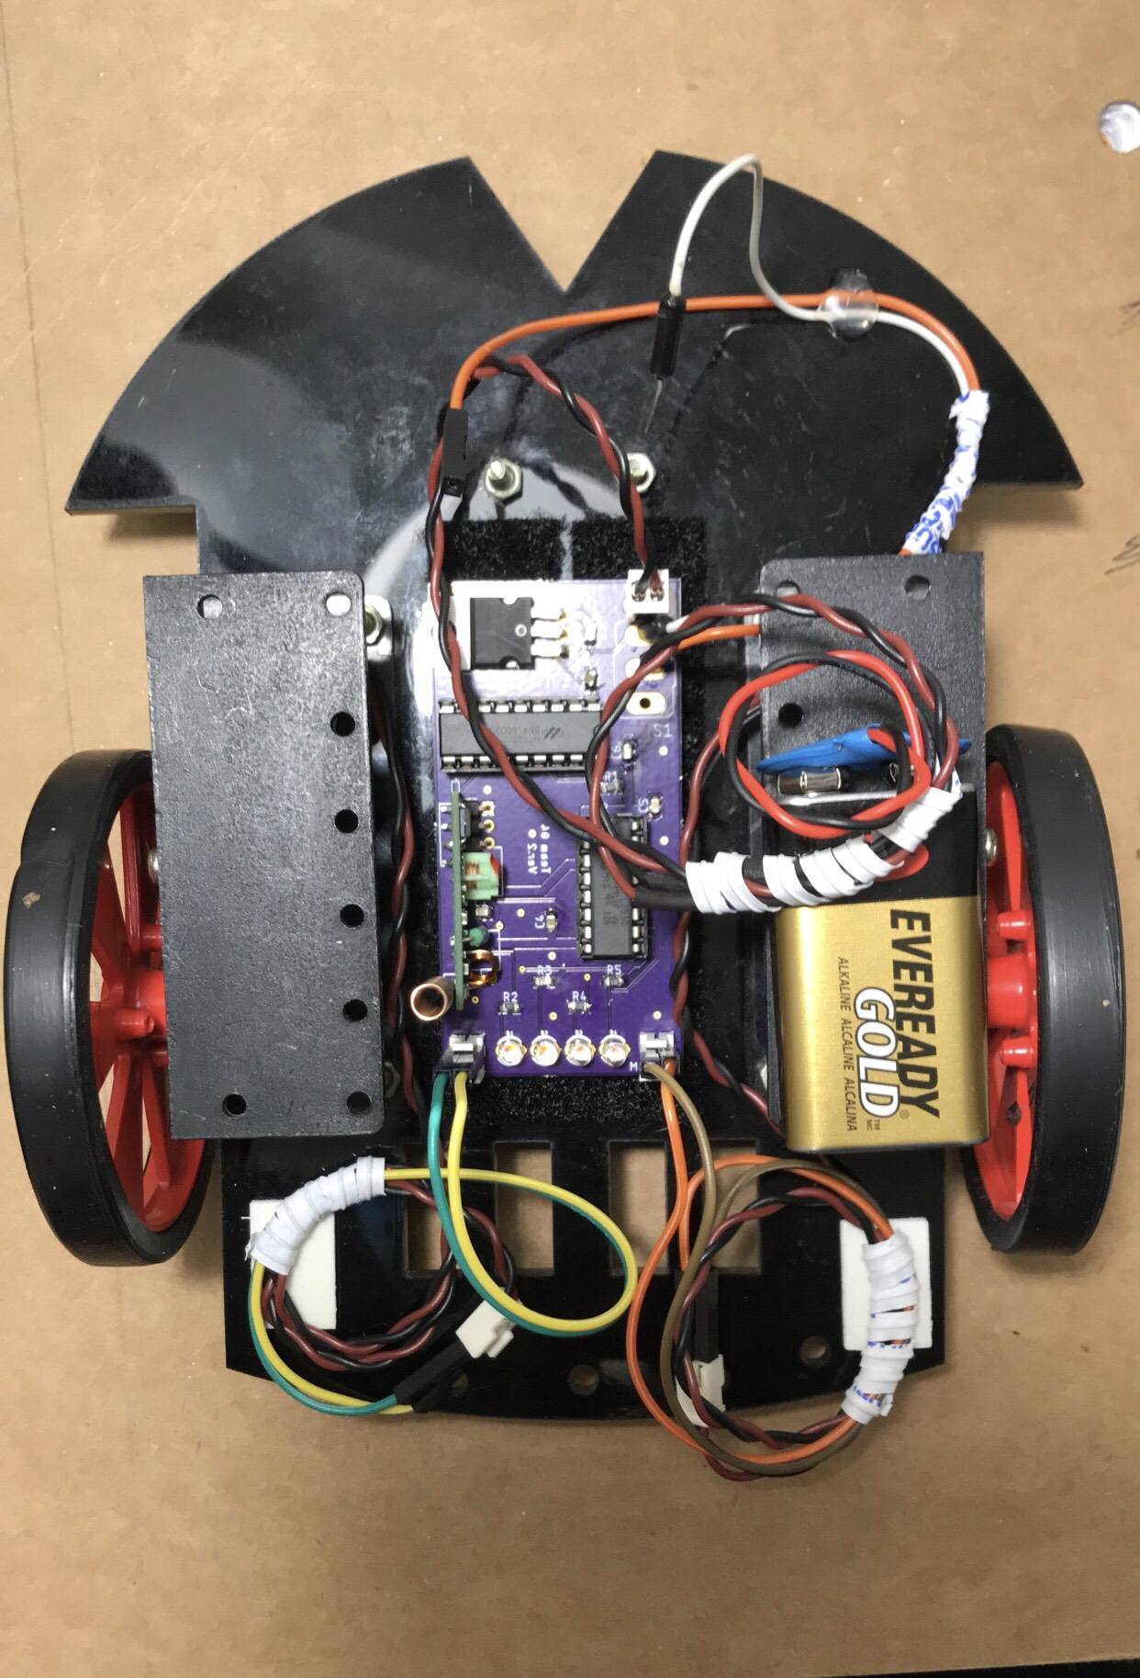
Results – Product

Slide 34
Results - Operation
Transmitter – receiver pair communicated as expected
Robot chassis moved when steered by hand gestures
Power details:
Transmitter – 23 mA ON current from 9 V battery. Expect 20 hours runtime on full charge
Receiver – 120 mA ON current from 9 V battery. Expect 3 hours runtime on full charge
Accelerometer did identify the changes in tilt and the code was implemented in a way to ensure stable changes in transitions of directions(forward, backward, left and right and intermediate directions)

Slide 35
Contributions
Gomathy | Mark | Tapas | Yebin
Led the team and distributed tasks to team members Designed and tested code on Prototype board and PCB Performed integrated and system tests for software | Documented the code Tested Rx and Tx pair Worked on TX/RX schematics and board layout | Performed unit and integrated testing for hardware Assisted in the soldering of the components onto board. Worked on the project presentation | Worked on TX/RX schematics and board layout Generated hardware test plans. Performed integrated testing for hardware
Notes:
Each person can elaborate what they did

Slide 36
Lessons Learned
Gomathy | Mark | Tapas | Yebin
Using Eagle CAD Schematic design code the Atmega chip via ICSP pins using AVR dragon using the accelerometer to recognize tilts. Using 640 for prototype boards. | Conducting Meetings effectively. Using EagleCAD: Layout and Schematic design. Coding with Arduino as programmer. Using accelerometer and Tx/Rx modules. | Testing the RX and Rx pair for range soldering components onto the PCB using transceivers schematic design testing the circuit (power test) | - Using EagleCAD to design schematics and board layouts - Overall design and operation of a project TX/RX communication - Debugging software - Developing documentations related to the project.

Slide 37
Possible Future Improvements
Have two microprocessors on the actual PCB.
This was done in the prototype PCB boards using the A640 printer in the EPL lab. Since it involved two MCUs, we decided to use a simplified version while designing the PCB boards.
Use a power supply regulator to take greater ranges of input voltages to control heavy power consumption vehicles or devices.
Create and use a wifi module to communicate wirelessly.
Notes:
ON top of this, each person can talk about what they’ve learned

Slide 38
Any Questions?

